Slide 1
DevOps Workshop Challenge
by Andre Guerra
Brazil, January 2024

Slide 2
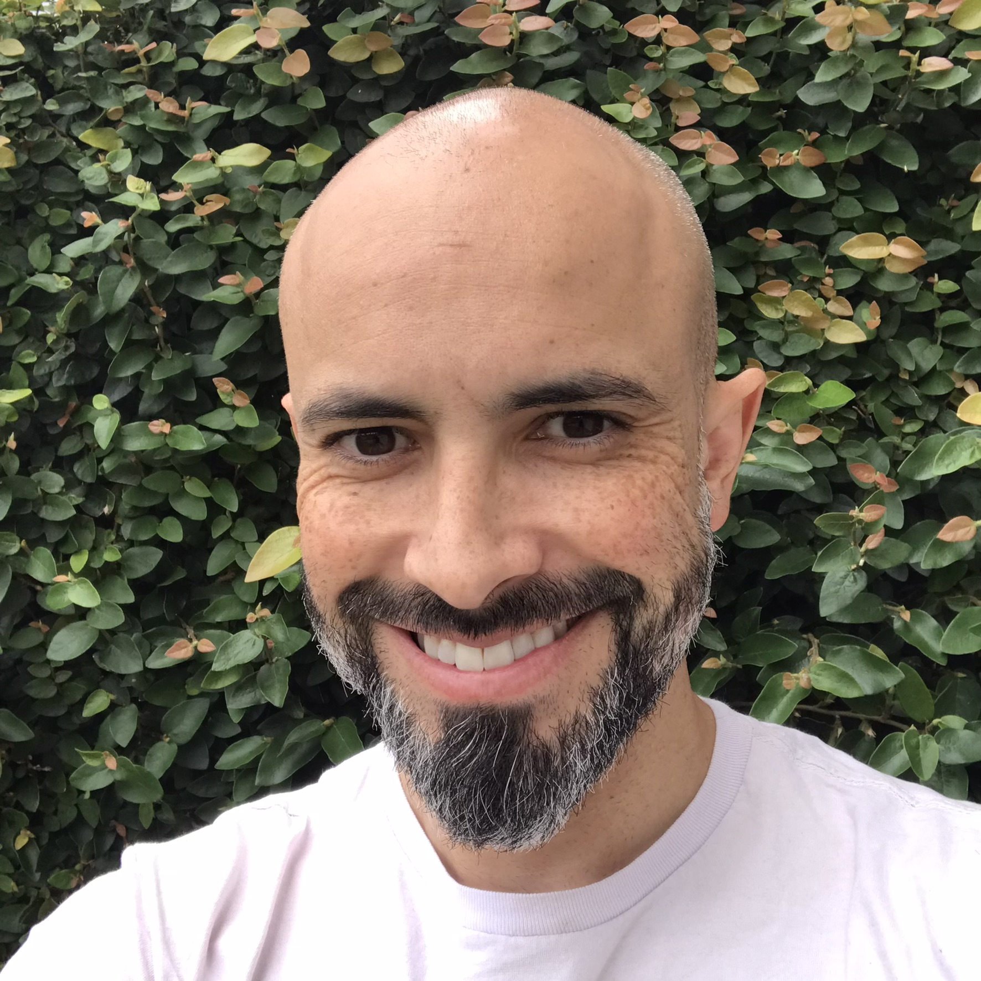
Who I am.
Electrical engineer turned IT professional.
Working in security related roles for... a while now.
With SAP for 3+ years.
Currently Lead Security Engineer for the Spark as a Service team (a HANA Cloud based product)

Slide 3
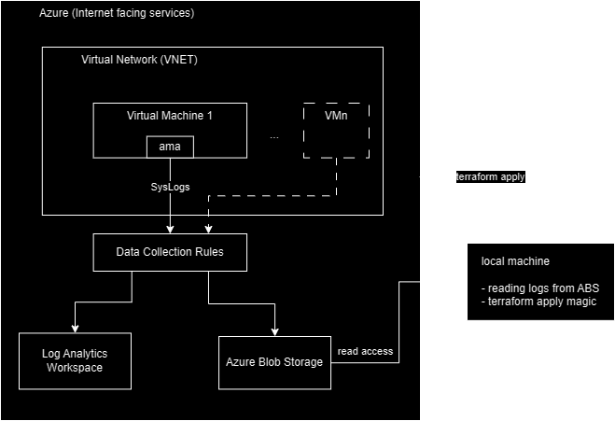
Overview
The most fun interview process I’ve ever completed.
Deploying Azure infrastructure via Terraform.
Creating a simple CLI application with Oauth client_credentials flow to display VM logs from Azure Blob Storage.

Slide 4

Execution & Challenges
Personal free-tier Azure account.
Capped costs at USD 200 (welcome free tier). (about 1 USD actually spent).
Migrated from macOS to WSL in the middle.
Evolved understanding of the solution. Not as many services required as in the original design.
Azure and Terraform docs were reliable (mostly).
ChatGPT was ok instead of Google for ad-hoc concepts. And was ocasially really good for really specific issues.

Slide 5
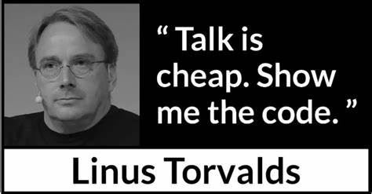
Show me!

Slide 6
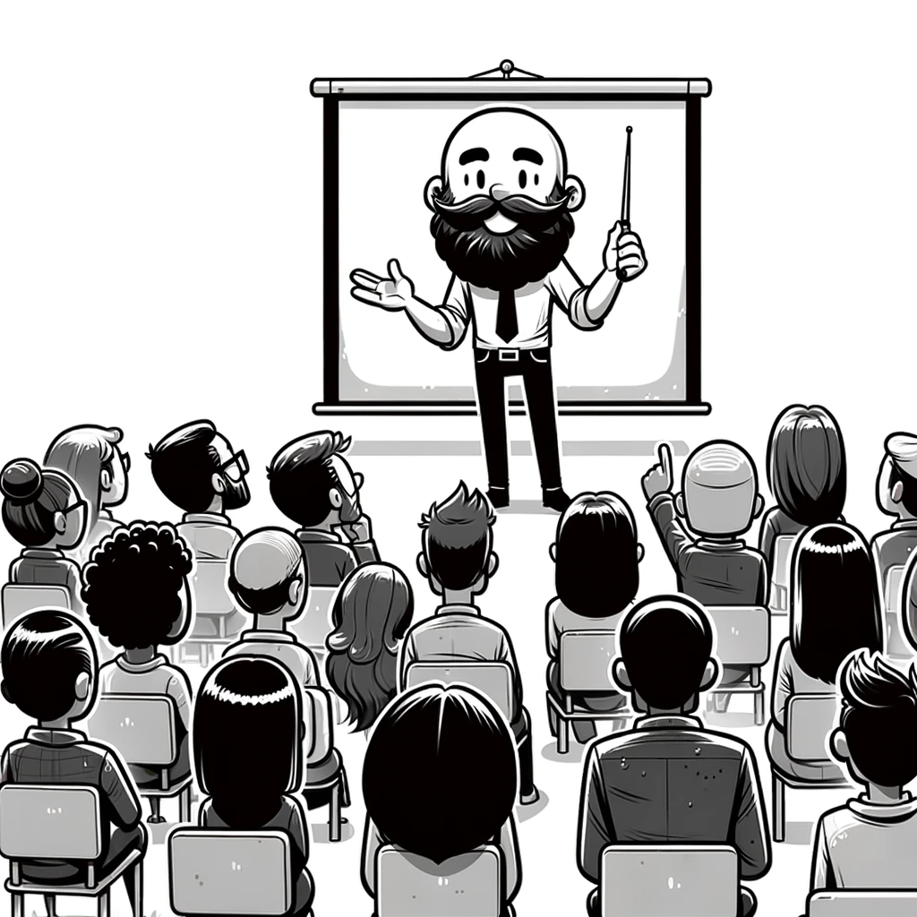
Questions?

